Slide 1

Academic Session 2025-26
Even Semester Jan-Jun’26
Apex Institute of Technology
Department of Artificial Intelligence and Machine Learning
System Design (23CST-390)
Faculty: (Er.) Kamaljeet Kaur (E19147)
DISCOVER . LEARN . EMPOWER
Lecture
Introduction to System Design

Slide 2
Learning Objectives
Understand the fundamental concepts of system design and its importance in building
scalable applications.
Learn the principles of scalability, availability, and reliability in large systems.
Differentiate between Monolithic and Microservices architectures.
Explain key performance metrics such as latency and throughput.
Understand how caching improves system speed and reduces load on backend services.

Slide 3
Course Outcomes
On completion of this course, the students shall be able to:-
CO1 | Understand the fundamental system design principles, including scalability, high availability, and fault tolerance, while analyzing how these core principles influence architectural decisions in real-world distributed environments.
CO2 | Apply various distributed architectural patterns, key database models (SQL and NoSQL), and critical communication protocols to evaluate their specific applications and trade-offs in modern system designs.
CO3 | Apply advanced scaling techniques, such as caching, load balancing, database sharding, and replication, to design system components that effectively handle massive user traffic and data volumes.
CO4 | Analyze the trade-offs between different system architectures, data storage solutions, and consistency models (like the CAP theorem) to select and justify optimized configurations for performance, cost, and reliability goals.
CO5 | Create and document comprehensive, end-to-end system designs that are inherently scalable, distributed, and fault-tolerant, leveraging modern paradigms such as cloud computing and microservices architecture.

Slide 4
Unit-1 Syllabus
Unit-1 | System Design
Introduction to System Design | Introduction to System Design, Functional & Non-Functional Requirements, Scaling Challenges, Load Balancing, Caching Strategies, Replication, Sharding.
Databases in System Design | Databases in System Design – SQL vs NoSQL, CAP Theorem, Distributed Databases, Consistency Models, Eventual Consistency, Distributed Caching (Redis, Memcached), High Availability, Fault Tolerance, Microservices vs Monolithic Architecture.

Slide 5
Topic to be Covered
      Load Balancing
Need of Load Balancing
Types of Load Balancers
Benefits of load balancing
Issues of Load Balancing

Slide 6
Load Balancing
9
A Load Balancer (LB) sits between clients and servers. It acts as a traffic cop, distributing incoming requests across multiple healthy servers.
Prevents overload on a single server.
Increases availability (reroutes traffic if a server dies).
Algorithms: Round Robin, Least Connections, IP Hash.

Slide 7
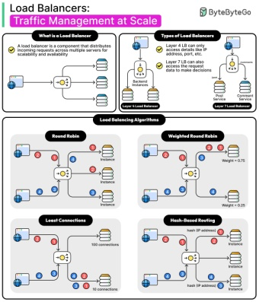
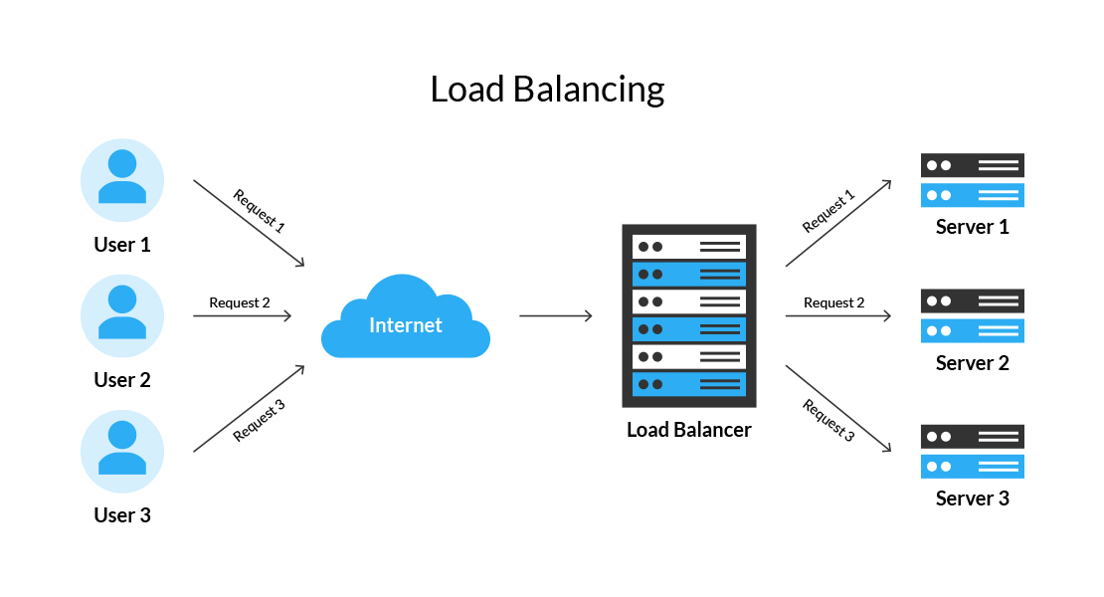
Load Balancing
9

Slide 8
Need of Load Balancing
Performance Improvement
When multiple servers share the workload, each server handles fewer requests → responses become faster.
Better Availability
If one server fails, traffic is sent to others → system stays online.
This ensures High Availability (HA).
Overload Prevention
If all traffic goes to one server, it may crash.
Load balancers distribute requests safely.

Slide 9
Benefits of load balancing
Scalability
You can add more servers when traffic grows.
The load balancer automatically starts sending traffic to the new server.
Fault Tolerance
Even if a server goes offline, users never notice.
Load balancer reroutes traffic immediately.
High Throughput
Overall system performance increases because workload is evenly shared.

Slide 10
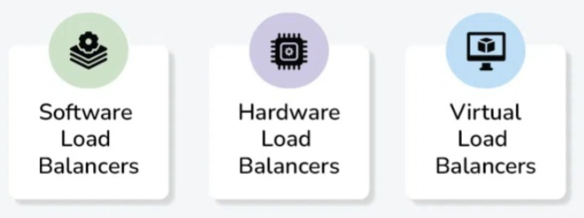
Types of Load Balancers
Hardware Load Balancers
Physical devices
Very fast and reliable
Expensive
Examples: F5, Citrix
Software Load Balancers
Run on general-purpose machines
Examples: NGINX, HAProxy
Cloud Load Balancers
Managed by cloud providers
Examples: AWS ELB/ALB,
Google Cloud LB, Azure LB
Highly scalable
No maintenance required

Slide 11
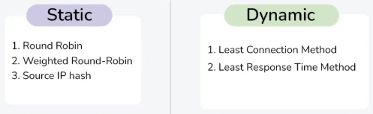
Load Balancing Algorithms
The goal is to make sure that no single server is overloaded when too many users visit an application.
Load balancing algorithms can be broadly categorized into two types: Dynamic load balancing and Static load balancing.

Slide 12
Static Load Balancing Algorithms (Cont…)
Static load balancing involves predetermined assignment of tasks or resources without considering real-time variations in the system. This approach relies on a fixed allocation of workloads to servers or resources, and it doesn’t adapt to changes during runtime.

Slide 13
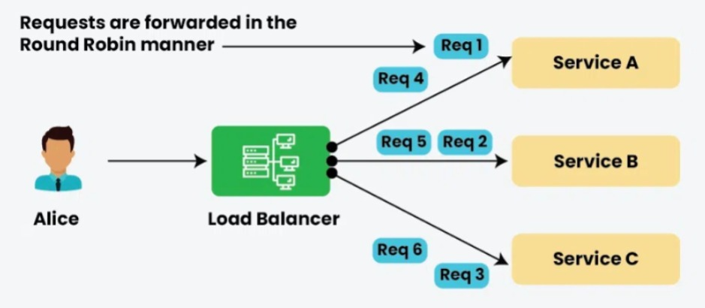
Round Robin Load Balancing Algorithm
The Round Robin algorithm is a simple static load balancing approach in which requests are distributed across the servers in a sequential or rotational manner. It is easy to implement but it doesn’t consider the load already on a server so there is a risk that one of the servers receives a lot of requests and becomes overloaded.

Slide 14
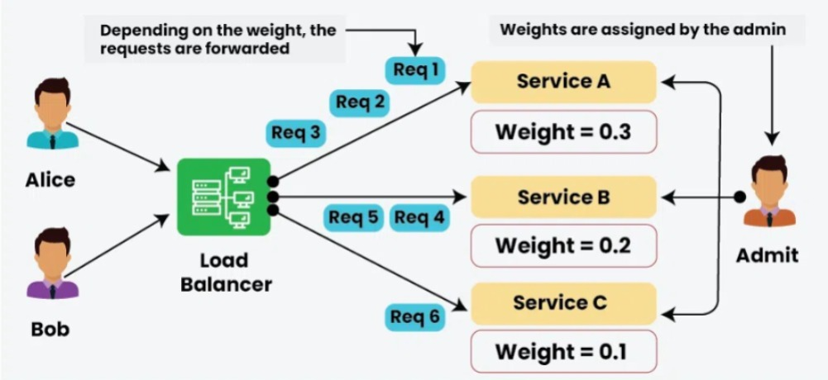
Weighted Round Robin Load Balancing Algorithm
It is also a static load balancing approach which is much similar to the round-robin technique. The only difference is, that each of the resources in a list is provided a weighted score.

Slide 15
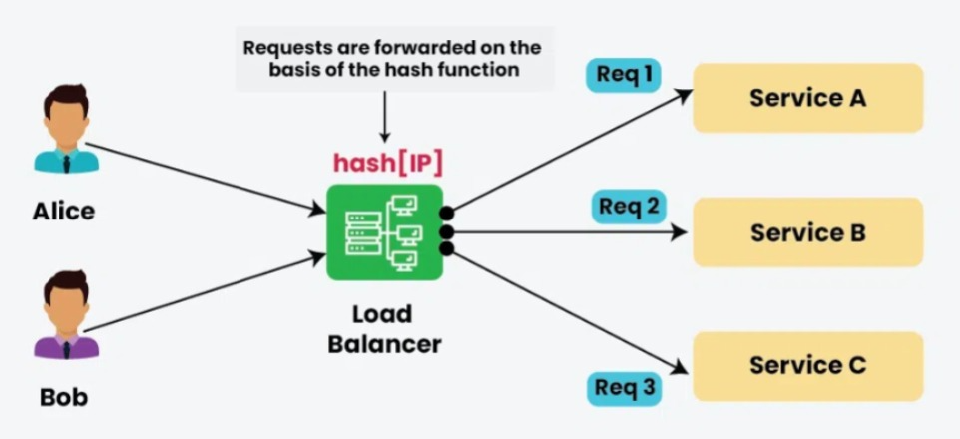
Source IP Hash Load Balancing Algorithm
It is a method used in network load balancing to distribute incoming requests among a set of servers based on the hash value of the source IP address. This algorithm aims to ensure that requests originating from the same source IP address are consistently directed to the same server.

Slide 16
Challenges in Load Balancing
Session Persistence
Users sometimes need to stay connected to a specific server (shopping cart, login session).
Global Traffic Distribution
Apps used worldwide must handle traffic from multiple regions → need Global Load Balancers (GSLB).
Failover Management
When multiple load balancers are used, ensuring one takes over if another fails is complex.

Slide 17
Summary of the Lecture
Load balancing is the process of distributing incoming network traffic across multiple servers to ensure no single server becomes overloaded.
It improves system performance, availability, and fault tolerance by allowing multiple servers to share workload efficiently.
Load balancers can be hardware-based, software-based, or cloud-managed, each offering different levels of scalability, cost, and flexibility.
Different load balancing algorithms such as Round Robin, Least Connections, Weighted algorithms, and IP Hash determine how requests are distributed.
Health checks are continuously performed to detect unresponsive or unhealthy servers, ensuring traffic is routed only to functional servers.
Load balancing helps in achieving high scalability, allowing more servers to be added easily as user traffic grows.

Slide 18
Next Lecture
Caching Strategies
Overview Client-Side vs Server-Side Caching
Replication Techniques
Sharding Strategies

Slide 19
Quiz
1. What is the main purpose of load balancing?
a) To increase latency
b) To distribute traffic across multiple servers
c) To reduce the number of servers
d) To slow down client requests
Answer: b
2. Which load balancing algorithm sends requests one after another in a rotating order?
a) Least Connections
b) IP Hash
c) Round Robin
d) Weighted Random
Answer: c
3. Which of the following ensures that the same user is routed to the same server?
a) Session Timeout
b) Server Caching
c) IP Hash
d) Health Check
Answer: c

Slide 20
FAQ’s
1. What is load balancing in simple words?
Load balancing is a method of distributing incoming user requests across multiple servers to prevent overload and improve performance.
2. Why is load balancing important for large systems?
It ensures the system is always available, performs well under heavy traffic, and avoids server failures by distributing workload.
3. What is the difference between Round Robin and Least Connections?
Round Robin: Cycles through servers equally.
Least Connections: Chooses the server with the fewest active connections.
4. What is a health check in load balancing?
A mechanism that checks whether a server is online and performing correctly.
Unhealthy servers are temporarily removed from traffic.

Slide 21
References/ Articles/ Videos
Book Reference:
Designing Data-Intensive Applications – Martin Kleppmann Chapters on scalability, reliability, load balancing, replication.
Site Reliability Engineering (SRE) – Google Concepts on reliability, traffic management, and load distribution.
Tutorial Link:
https://www.youtube.com/watch?v=chyZRNT7eEo
Video Link:
https://www.youtube.com/watch?v=sCR3SAVdyCc

Slide 22

Class-Wise Feedback

Slide 23
Thank You
For queries Email: kamaljeet.e19147@cumail.in

